Slide 1

QUANTITATIVE ANALYSIS OF CANDIDATE IN 2019 LOK SABHA ELECTIONS
Presented by
SHALINI P R P (611220104136)
SHALINI V (611220104137)
SHARULATHA B (611220104138)
SIVASAKTHI M (611220104143)
UNDER THE GUIDANCE OF
Mr. M.GOPIKUMARAN B.TECH,M.E.,
ASSISTANT PROFESSOR,
DEPARTMENT OF COMPUTER SCIENCE AND BUSINESS SYSTEM

Slide 2
INTRODUCTION
This project on the quantitative analysis of candidates in the 2019 Lok Sabha Election aims to provide a comprehensive understanding of the electoral landscape, which can be invaluable for research, policy-making, and public awareness.
The "Quantitative Analysis of Candidates in the 2019 Lok Sabha Election" project seeks to delve into the extensive electoral data of the 2019 Indian General Elections, encompassing candidate demographics, educational qualifications, professional backgrounds, party affiliations, criminal records, and campaign finances.
The project's ultimate goal is to offer a data-driven perspective on this significant democratic event, facilitating informed discussions, policy recommendations, and future research in the field of Indian politics.

Slide 3
ABSTRACT
The 2019 Lok Sabha elections in India were a pivotal moment in the nation's political landscape, with more than 8,000 candidates vying for 545 seats.
This study aims to provide a comprehensive quantitative analysis of these candidates, their demographics, and electoral performance.
The analysis reveals significant insights into the composition of candidates across different political parties and regions.
This project aims to conduct a comprehensive quantitative analysis of these candidates and their electoral performance.

Slide 4
LITERATURE SURVEY
PAPER-I
TITLE: Quantitative analysis of candidates in 2019 Lok Sabha Election.
AUTHOR: Roberto Cerina,2021
In a study published in 2021, In Nov, Recent technological advances have facilitated the collection of large-scale administrative data and the online surveying of the Indian population. Building on these we propose a strategy for more robust, frequent and transparent projections of the Indian vote during the campaign.

Slide 5
LITERATURE SURVEY
PAPER-II
TITLE:Quantitative analysis of candidates in 2019 Lok Sabha Election.
AUTHOR: Ranbir Singh, 2022
In a study published in 2022, In Oct, The essence of India as the largest democracy lies in its electoral strength and voter participation. A thriving and vibrant electoral democracy has been India’s distinct identity at the global stage. In a country of over 950 million eligible voters, conducting elections with the sheer scale, size, diversity and complexities of Indian democracy, albeit challenging, is an extremely rewarding process.

Slide 6
LITERATURE SURVEY
PAPER-III
TITLE: Quantitative analysis of candidates in 2019 Lok Sabha Election.
AUTHOR: Shashi Tharoor, 2023
In a study published in 2023, In Aug, Ashoka University faculty claiming “significant irregularities” in the 2019 Lok Sabha election data and the ruling BJP winning a “disproportionate share of closely contested elections” has triggered a controversy with ruling party supporters locking horns with the supporters of the “scholarly” work.

Slide 7
DRAWBACKS IN EXISTING SYSTEM
The reliability of quantitative analysis heavily depends on the quality and accuracy of the data.
Therefore errors or omissions in official records can lead to inaccurate conclusions.
Quantitative analysis may provide statistics and correlations but can lack the depth of context that qualitative research methods can offer.
Political landscapes can change rapidly, and data from a single election may not fully capture evolving political dynamics.

Slide 8
PROPOSED SOLUTION
Gather comprehensive data on each candidate, including their name, party affiliation, educational background, criminal record, previous political experience, and other relevant personal details.
Create visual representations of the data, such as bar charts, pie charts, and maps, to make it easier to understand and interpret the findings.
Calculate the swing in vote share for each party compared to previous elections.
Determine the percentage of candidates who won in their respective constituencies.

Slide 9
ADVANTAGES
Quantitative analysis relies on empirical data and evidence-based conclusions that provides a solid foundation for understanding the election dynamics.
Researchers can compare candidates across different constituencies, regions, and political parties, which aids in identifying variations and commonalities.
The results can inform policymakers and political strategists, helping them make informed decisions regarding candidate selection and election strategies.

Slide 10
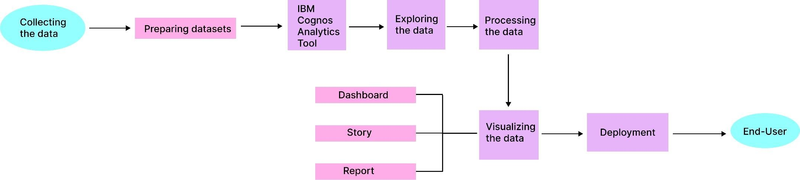
WORKFLOW DIAGRAM

Slide 11
SYSTEM SPECIFICATION
HARDWARE USED:
Processor - IAMD/INTEL
RAM - 4GB Hard Disk - 256 GB
SOFTWARE USED:
Language - Python,HTML,CSS AND Javascript
Framework - Flask
Package Manager
& Build Tool - PIP
Database - IBM_DB2
Service - SendGridAPI(Email)

Slide 12
MODULES
1. Authentication
2. Home
3.About
4. Analysis Page

Slide 13
MODULE DESCRIPTION
1. Authentication: Authentication is the first line of defense against unauthorized access and cyber threats. By understanding the importance of authentication, choosing the right methods, and following best practices, organizations and individuals can establish a secure and trustworthy digital environment.
2. Home: We hope you find inspiration, information, and a sense of belonging here. Just as a house becomes a home with love and care, this page becomes complete with your presence. Welcome to the journey of making every space your own and turning every house into a cherished home.

Slide 14
MODULE DESCRIPTION
3. About: The quantitative analysis of candidates in the 2019 Lok Sabha elections in India involved assessing various factors, including the number of candidates, their demographics, party affiliations, and electoral outcomes. A total of 8,049 candidates contested for 545 constituencies, with 78 women candidates.
4. Analysis Page: In Analysis page,We hope you find our insights valuable and informative. Our goal is to provide you with the knowledge and data-driven perspectives that can help you make informed decisions and understand the world around you.

Slide 15
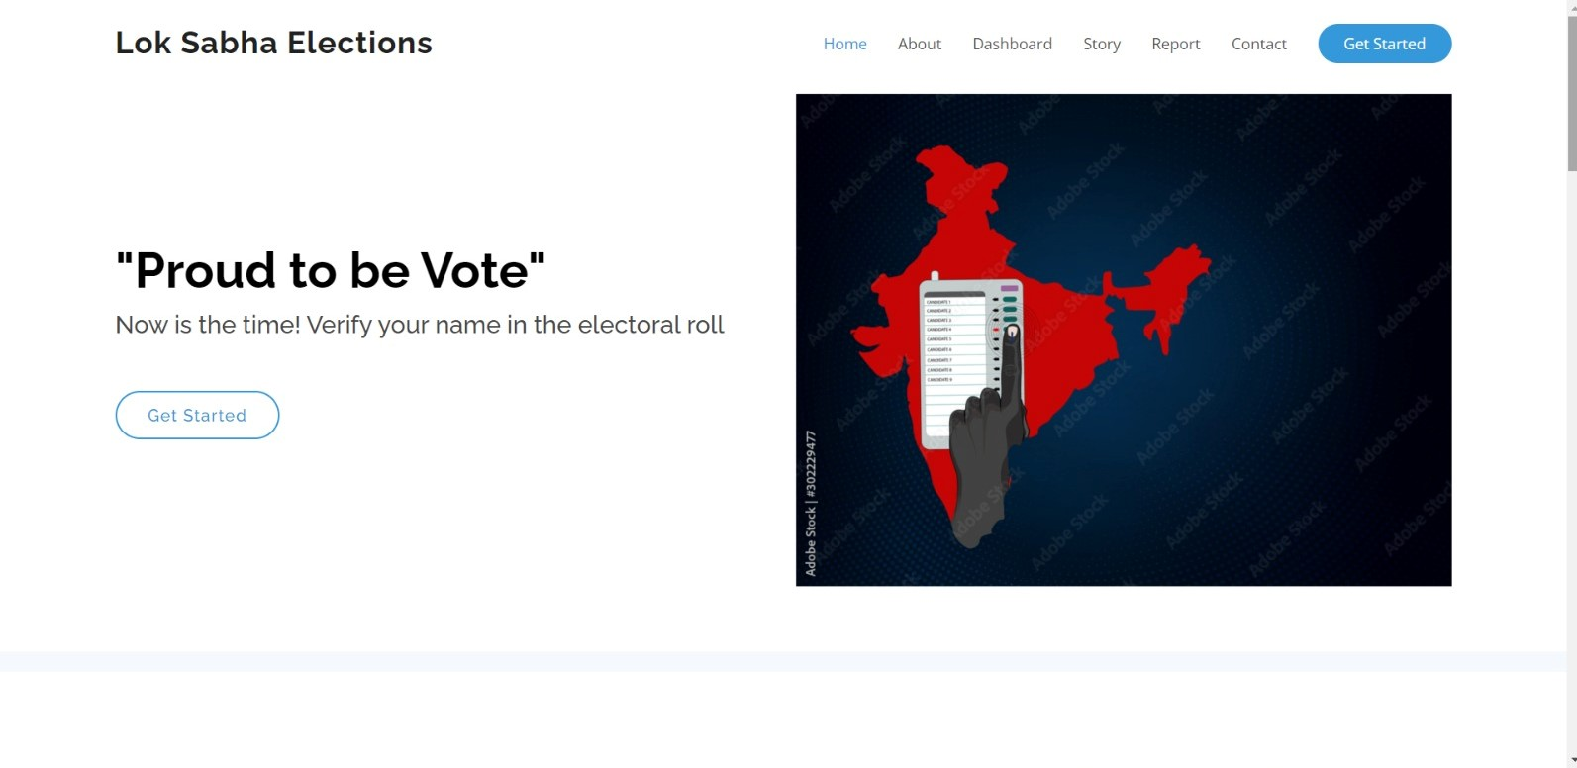
RESULT AND DISCUSSION

Slide 16
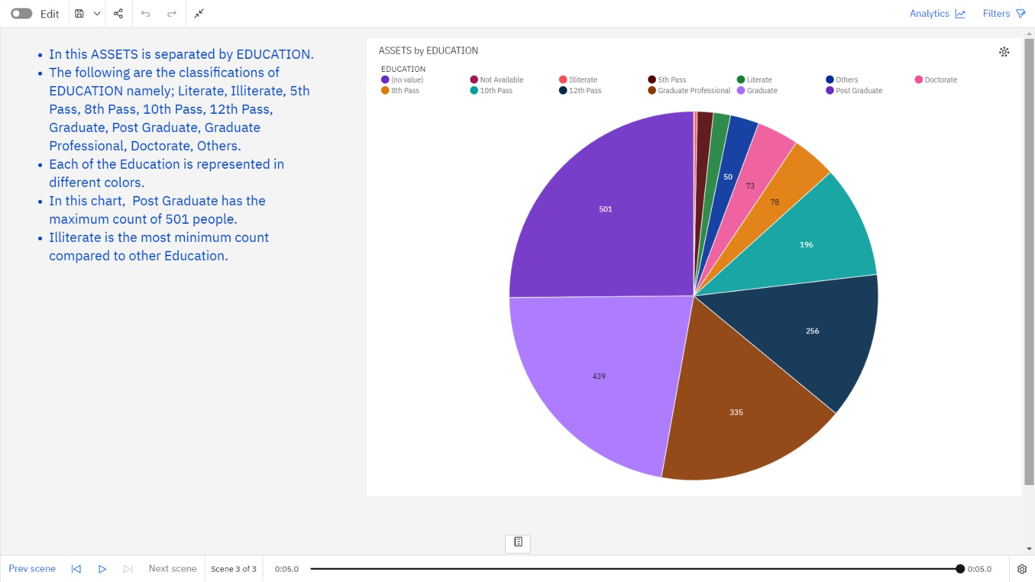
RESULT AND DISCUSSION

Slide 17
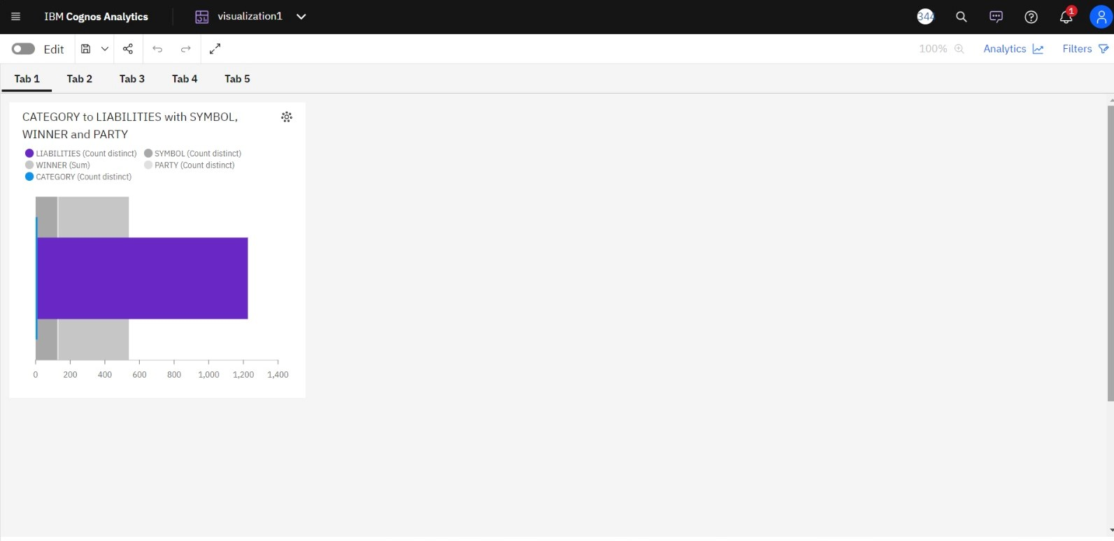
RESULT AND DISCUSSION

Slide 18
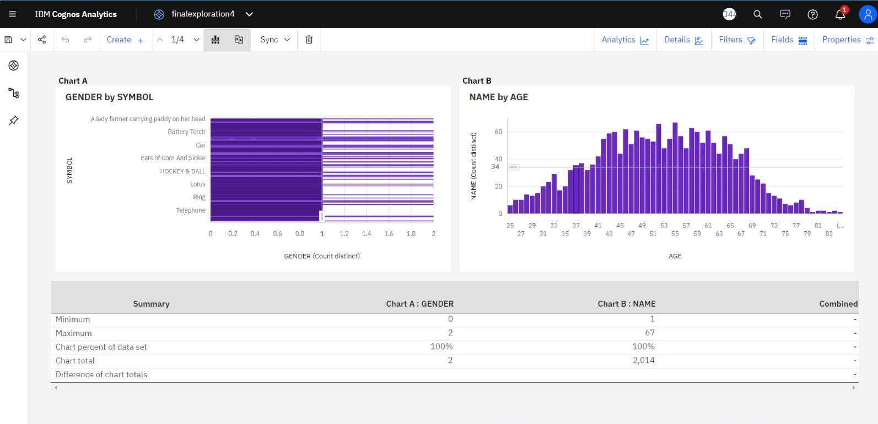
RESULT AND DISCUSSION

Slide 19
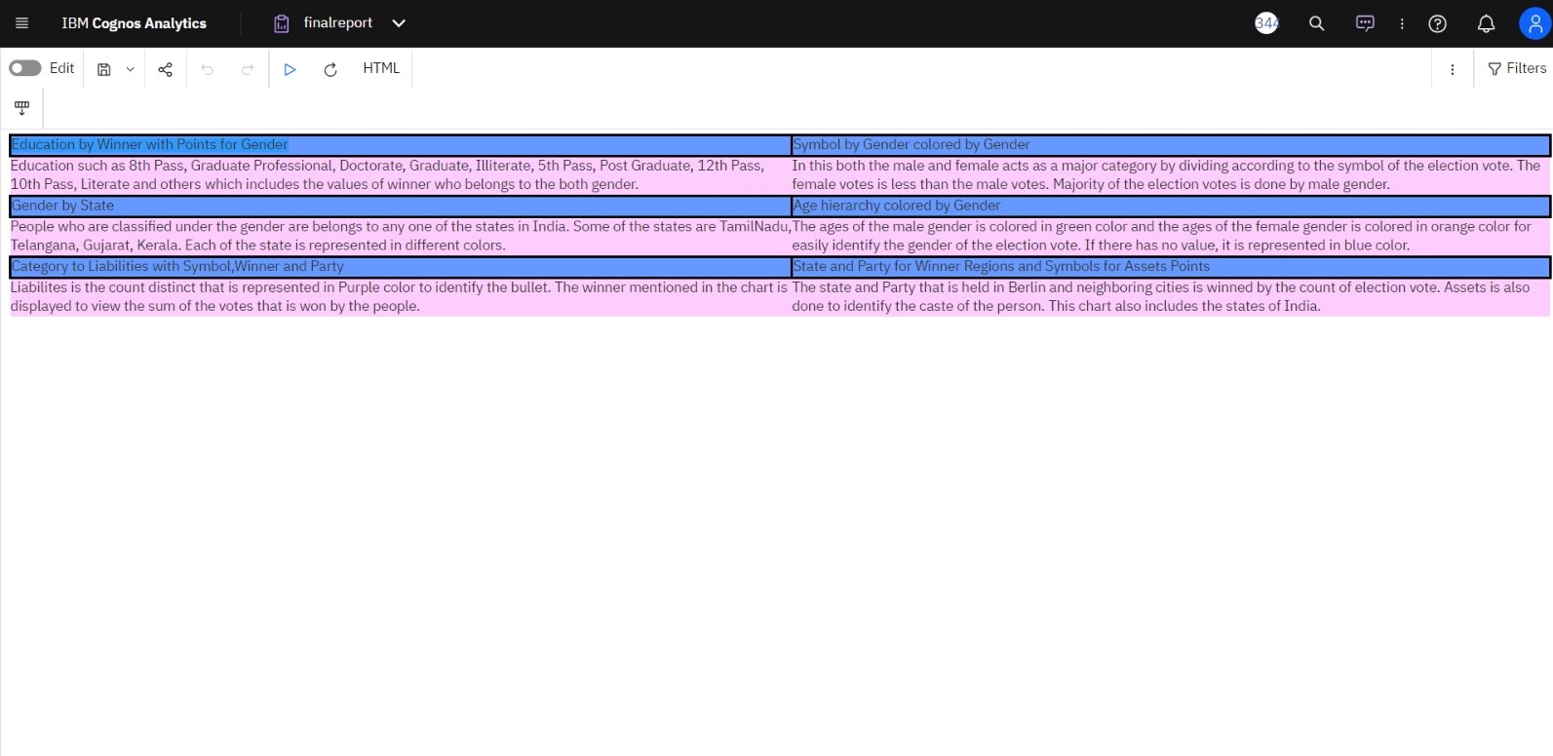
RESULT AND DISCUSSION

Slide 20
CONCLUSION
The study underscores the diversity of candidates who contested in the 2019 Lok Sabha elections.
The presence of candidates with criminal charges remains a pressing concern.
The data reveals a significant number of candidates facing criminal charges.
This has allowed us to identify statistical significance and correlations between variables such as demographics, education, and electoral performance.

Slide 21
FUTURE SCOPE
Analysis of the key promises made by candidates and parties.
Analysis of the prominent social and economic issues in different constituencies.
Develop visual representations like charts, graphs, and maps for easy data interpretation.
Use historical data to build models predicting election outcomes or voter behavior.
Assess how different factors and scenarios might have affected the election results.

Slide 22
THANK YOU

